Slide 1

Light Waves

Slide 2
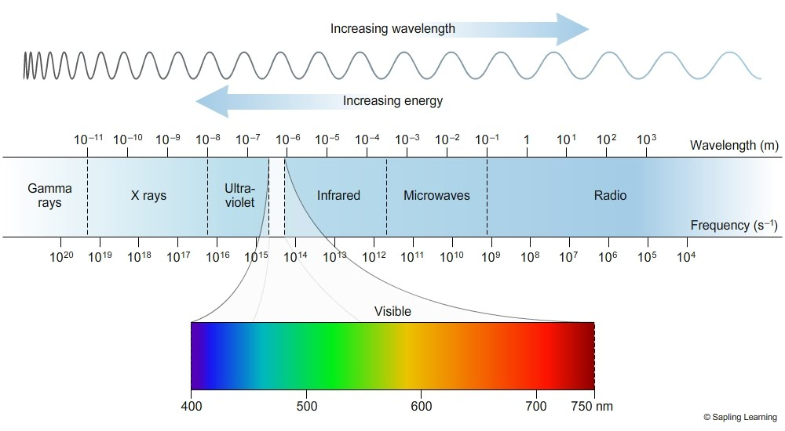
What is Light?
Light is the range of frequencies of the electromagnetic spectrum that stimulate the retina of the eye.

Slide 3
Light & Matter
Transparent (Glass): Materials that allow light to pass through (transmit) without distorting images.
Translucent (Cloudy Glass): Materials that allow light to pass through them, but do not allow them to be seen clearly.
Opaque (Brick): Material in which all light is absorbed or reflected. None of the energy is transmitted through.

Slide 4

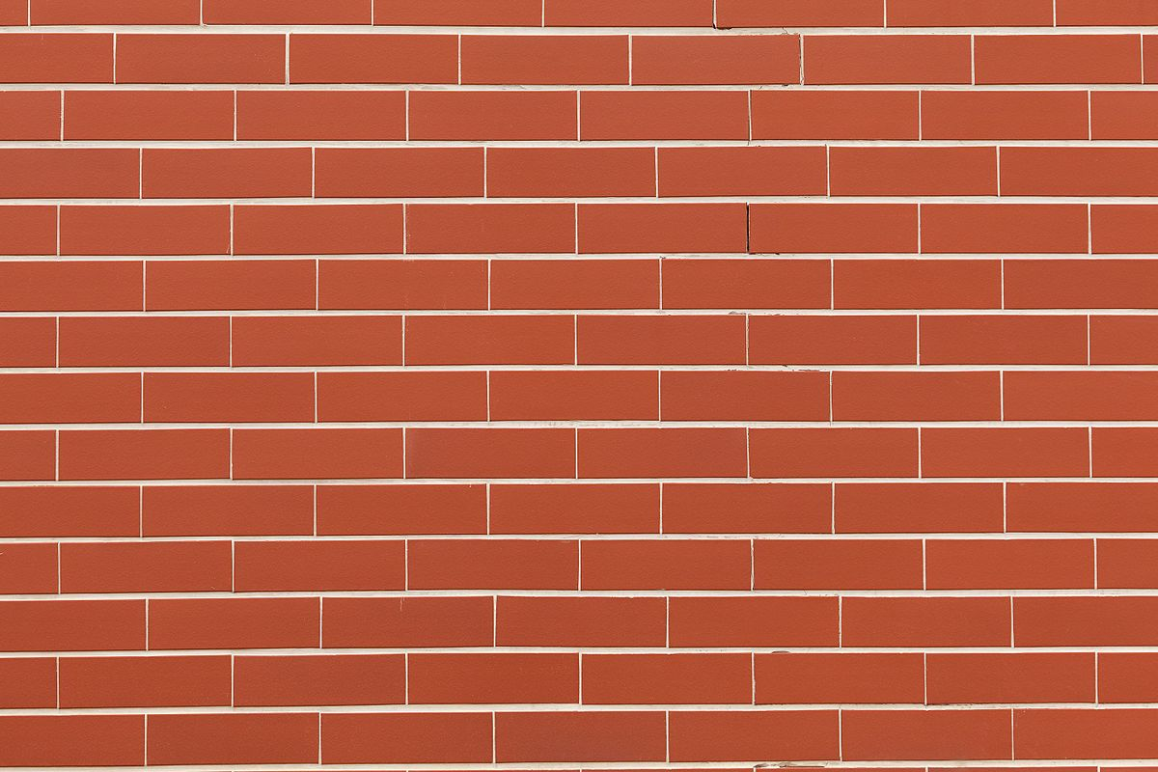
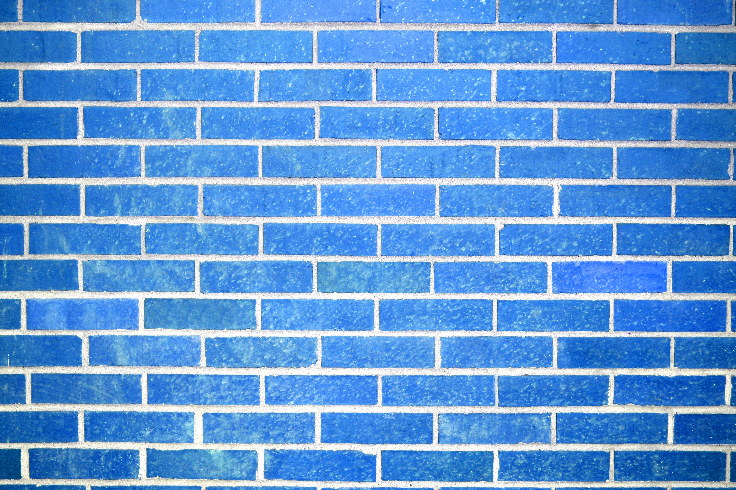
Reflection and Absorption of Light and Color
The color observed by any object is the same as that not absorbed by the object. For example, a red block will absorb all colors of the EM visible light spectrum except for red.
  How does this apply to the clothes we wear?
This Photo by Unknown Author is licensed under CC BY
This Photo by Unknown Author is licensed under CC BY-SA

Slide 5
Law of Reflection
The angle of incidence with respect to the normal is equal to the angle of reflection.
θ_{i} = θ_{r}

Slide 6
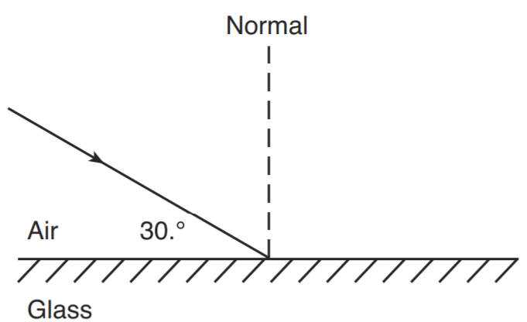
Example: Law of Reflection
What is the angle of incidence?
What is the angle of reflection?
What is the angle between the incident and relected rays?
60º
60º
120º

Slide 7
Specular & Diffuse Reflection
Light incident upon an object with a smooth surface will create specular reflection.
Light incident upon an object with a rough surface will create diffuse reflection.

Slide 8
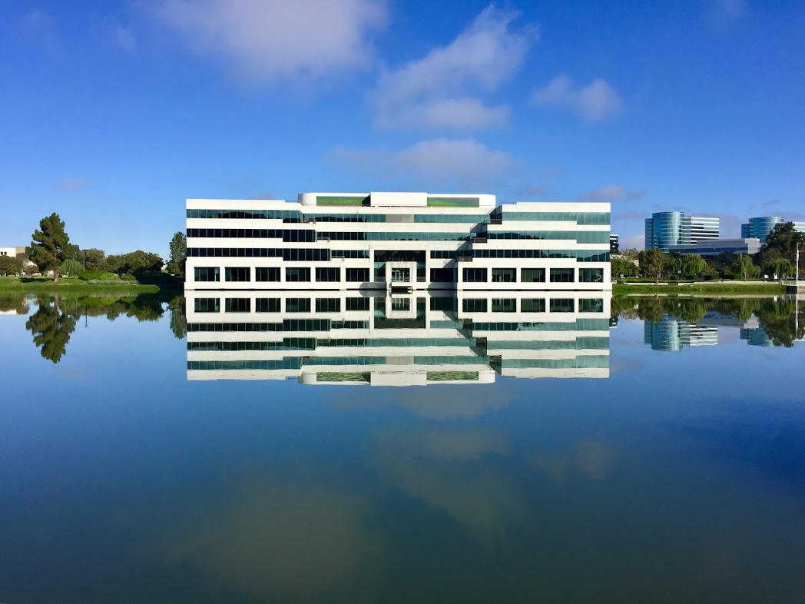
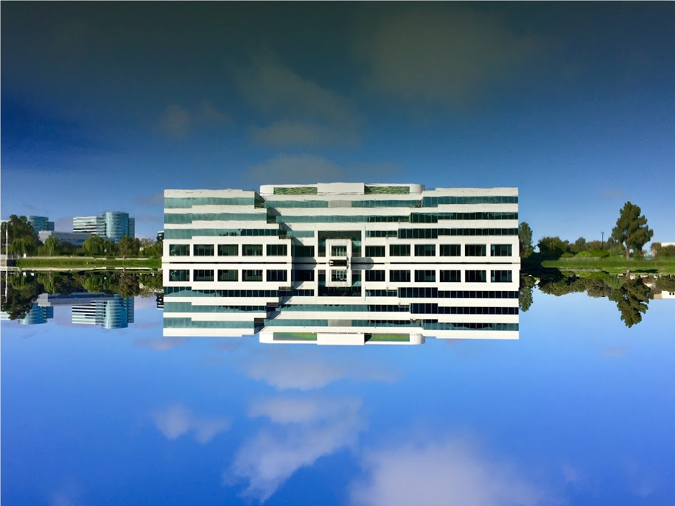
Which one is right?

Slide 9

Transmission

Slide 10
How do waves act when they hit a boundary between two different materials?
When a light wave impacts a boundary, some of the light will be reflected, some will be absorbed, and some will pass right through.
  The wave that passes through is called a transmitted wave.
  A wave that is transmitted through a boundary will have less energy than the incident ray.
Electromagnetic radiation will both slow down and have a shorter wavelength when going into a denser media.
Sound, on the other hand, will increase in speed when transitioning into a denser media.

Slide 11
Continuous Waves – Higher Speed to Lower Speed
Note the differences in wavelength and amplitude between of the wave in the two different mediums
Incident + Reflected Wave
Transmitted Wave
v₁
-v₁
v₂
Displacement
Boundary
Higher speed
Longer wavelength
Lower speed
Shorter wavelength
Note: This phenomena is seen with light traveling from air to water.

Slide 12
Continuous Waves (cont.)
Air
Glass
Air
Fast
Long λ
Slow
Short λ
Fast
Long λ
Frequency (f) does not change when a wave travels from one medium (air) to another (Glass).

Slide 13
Speed of Light and the Index of Refraction
The index of refraction, by definition, is the ratio of the speed of light in a vacuum to the speed of light in a substance.
The index of refraction is always greater than 1.
Speed of Light in different mediums

Slide 14
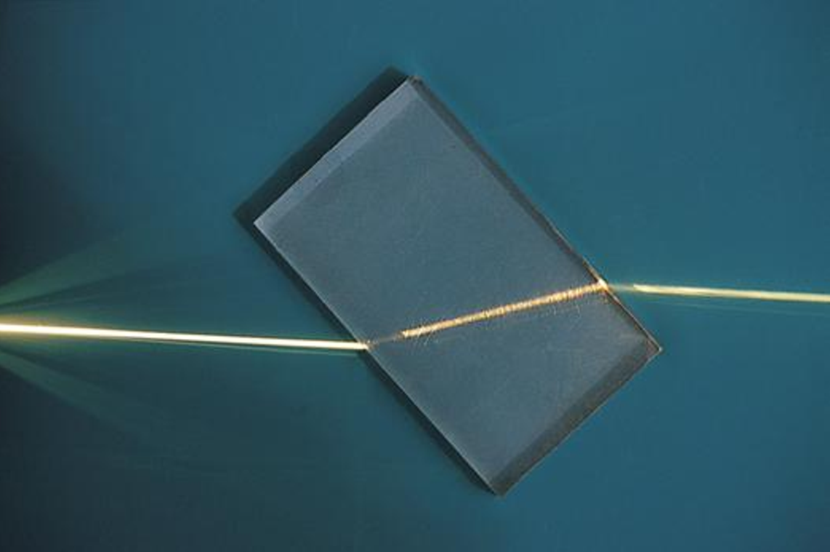
Refraction

Slide 15
Refraction of Light
When light travels through a surface between two different media with different indices of refraction, the light will be refracted (BENT) if the angle of incidence is greater than zero degrees.
If light is passing into a more dense medium, it will bend towards the normal with the boundary.
Refraction

Slide 16
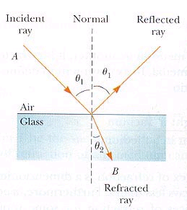
Law of Refraction (Snell’s Law)
The ratio of the sine of the angle of incidence to the sine of the angle of refraction is a constant.
  n₁ sinθ₁ = n₂ sinθ₂
  Where:
  n₁, n₂ = index of refraction
  θ₁ = Angle of incidence
  θ₂ = Angle of refraction
Note, the incident ray will always
bend towards the normal when
transitioning from a material with
a lower index of refraction to one
with a higher index of refraction(n₂>n₁).
www.sol.sci.uop.edu

Slide 17
Light Passing Through Glass
Air
Glass
Air
Reflected
Ray
Refracted
Ray
θ₄
θ₂
θ₃
θ₁
Incident
Ray
Note: θ₁ = θ₄
θ₂ = θ₃

Slide 18
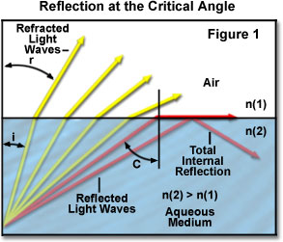
Total Internal Reflection
When the angle of incidence is such that the angle of refraction is equal to 90º, the critical angle (θ_{c}) has been attained.
All rays will be reflected internally at all angles greater than this angle.
θ_{c} = sin⁻¹ (n₂/n₁)
Note: Internal reflection can
only occur if n₂ < n₁.
Internal Reflection
Application – fiber optic
cable
2
1
1
2
www.micro.magnet.fsu.edu

Slide 19
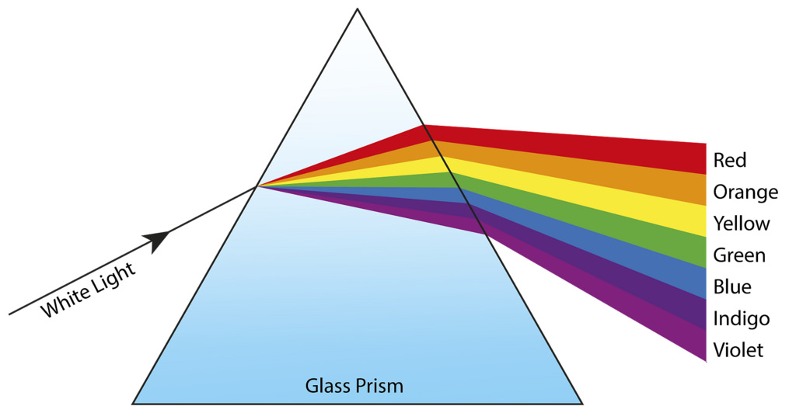
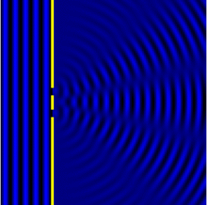
Chromatic Dispersion & Diffraction and Interference

Slide 20
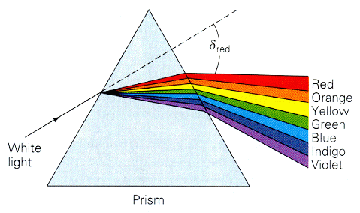
Chromatic Dispersion
If the angle of incidence is greater than zero, the wave will exhibit chromatic dispersion.
When white light enters a medium, the different wavelengths that comprise the light will travel at different speeds.
Note: The shorter
the wavelength, the
greater the bending.
What happens to
the frequency?
  NOTHING
www.physics.uiowa.edu

Slide 21
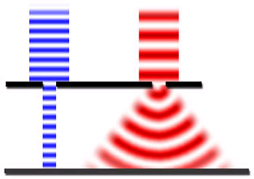
Diffraction of Light
When a wave front is incident on a barrier with an opening, the wave will spread out after crossing the barrier. This process is called diffraction.
  Diffraction is an interference phenomena.
As the slit becomes narrower, the amount of diffraction will increase.
As the wavelength of light increases, the amount of diffraction will increase.
Diffraction
Notes:
Show diffraction with diffraction grating and laser.

Slide 22
Is light a Wave?
Young Double-Slit Experiment:
  The wave properties of light were first demonstrated by Thomas Young in 1801.
  Showed that light undergoes interference in and diffraction in much the same way that water and sound waves do.
  Used a source of monochromatic light so that only one wavelength was chosen. Also used light with no phase difference.

Slide 23
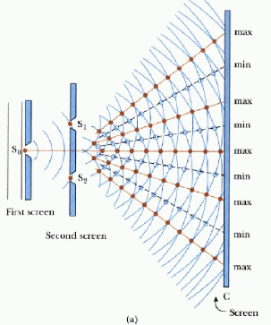
Young Double-Slit Experiment
Huygen’s Wavelets
www.src.wits.ac.za

Slide 24
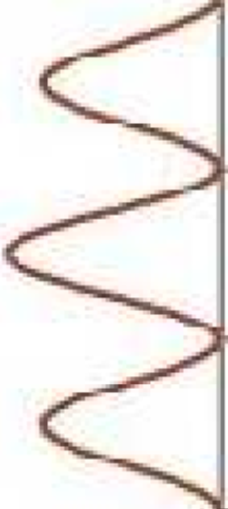

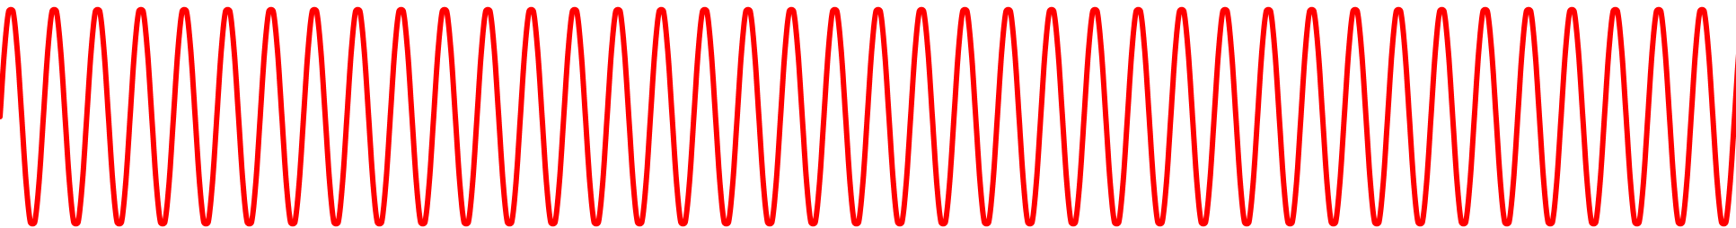




Young Double-Slit Experiment
In order for Constructive Interference (CI) to occur, the path difference between r₁ and r₂ must be equal to some multiple of λ where:
By inspection of the right triangle, the hypotenuse is the distance between the two slits (d) and $$ is the path difference.
Hence:
$$ (delta)=r2–r1$$
$m=r2–r1$ ($m=0, 1, 2,…$)
r₁
CI
DI
θ
$$\sin{θ}=\frac{mλ}{d}$$
d
r₂
CI
DI
δ
D
CI
Screen

Slide 25



Young Double-Slit Experiment
Finding y
If we assume that D is very big compared to d, r₁ and r₂ can be considered parallel
  Therefore the the angle they make with the normal to the surface will be θ
To determine the distance y between the central axis and first maximum, we will use some basic trig to get.
r₁
$$tan⁡θ=\frac{y}{D}$$
$≈$θ
y
r₂
$≈$θ
d
Central Axis
θ
D
Screen

Slide 26



Young Double-Slit Experiment
For small angles of θ, $tan=sin$ (try comparing $tan\left(1°\right) to sin\left(1°\right)$).
Therefore, we can set the last two expressions equal to each other and solve for y
$$tan⁡θ=\frac{y}{D}$$
$$\sin{θ}=\frac{mλ}{d}$$
r₁
r₂
y
$≈$θ
d
θ
Central Axis
δ
D
Screen

Slide 27
Young Double-Slit Experiment
What are the implications of the formula?
  As wavelength (λ) and distance (D) to the screen increases, the distance between maximums increases.
  As the distance between slits (d) increases, the distance between maximums decreases.

Slide 28
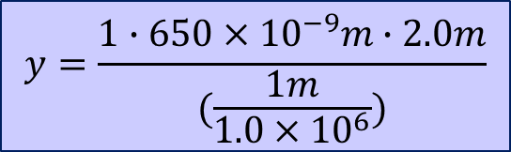


Example
A red laser that emits radiation at 650nm is used to shine a beam of light through a diffraction grating with 10,000 slits/cm. If the diffraction grating is 2.0m from the screen, what will be the distance between the central maximum and the first maximum?
$$y=\frac{mλD}{d}$$
$$y=\frac{1∙650×{10}^{−9}m∙2.0m}{(\frac{1m}{1.0×{10}^{6}})}$$
$$y=1.3 m$$

Slide 29

Diffraction Gratings
Used to study light emitted by objects such as gas lamps and stars.
Used in CD players to track properly.
Instead of one or two slits, ……. Try
40,000 slits/cm!
d = 2.5 x 10⁻⁷m
Note: A CD has approximately 6,250 grooves/cm which
causes dispersion of light creating a rainbow effect.

Slide 30
Key Ideas
Transverse waves such as electro-magnetic radiation do not require a medium.
Light Waves travel at different speeds in different mediums. It slows down when going from air to a liquid or solid.
Waves can interfere with one another resulting in constructive or destructive interference.
The law of reflection states that angle of incident wave equals the angle of the reflected wave.

Slide 31
Key Ideas
Snell’s Law / Law of Refraction: A wave will bend toward the normal when transitioning from a media with a low index of refraction (e.g. air) to a media with a higher index of refraction.
Total internal reflection occurs when the angle of incidence is greater than the critical angle. Consequently, no light will escape.
Diffraction is the spreading out of a wave when it encounters a barrier.
Thomas Young’s double slit experiment showed that light has wave properties similar to water and sound.

Slide 32
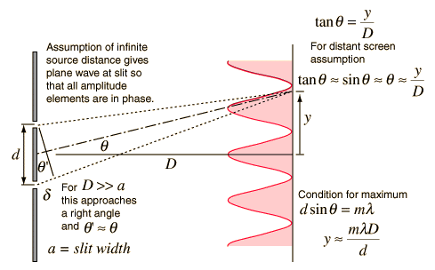
Young Double Slit Experiment
www.hyperphysics.phy-astr.gsu.edu

